Slide 1
Bray Team Week 14 Update
Avery Haynes, Locke Lehmann, Travis Carlson, Cody Sims, Zachary Walker, Michael Hager
11/20/2023

Slide 2
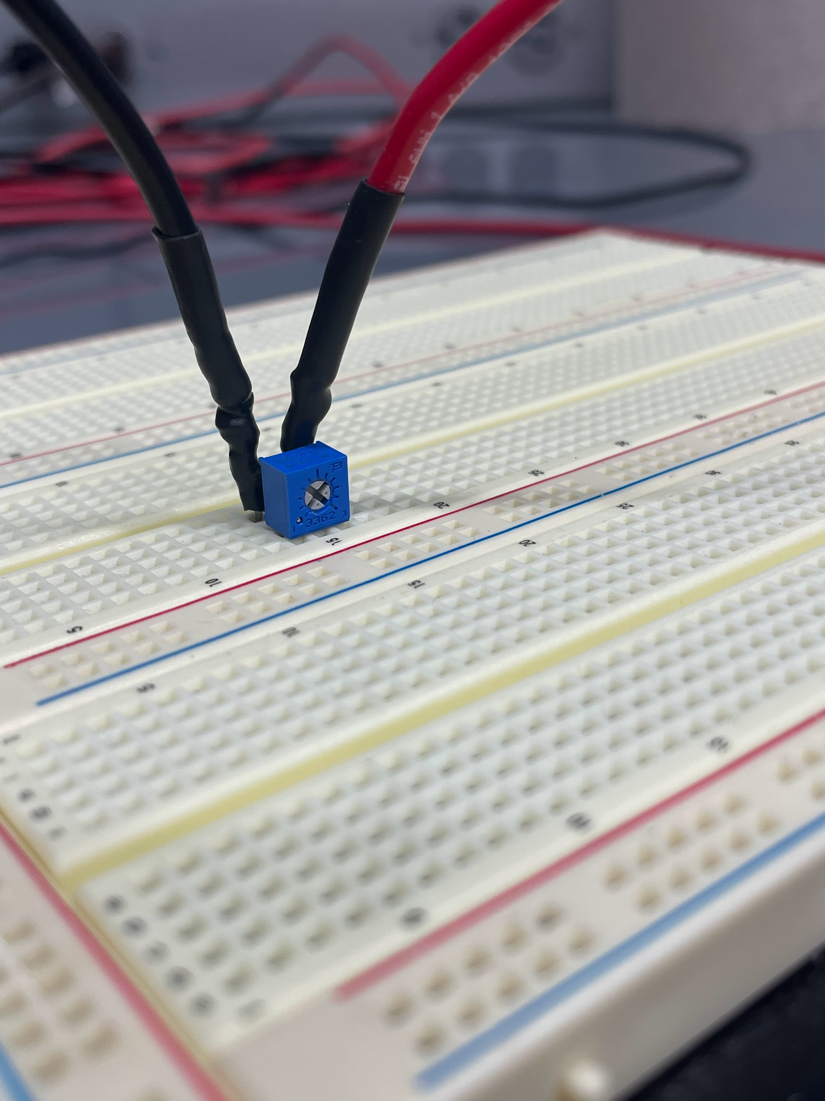
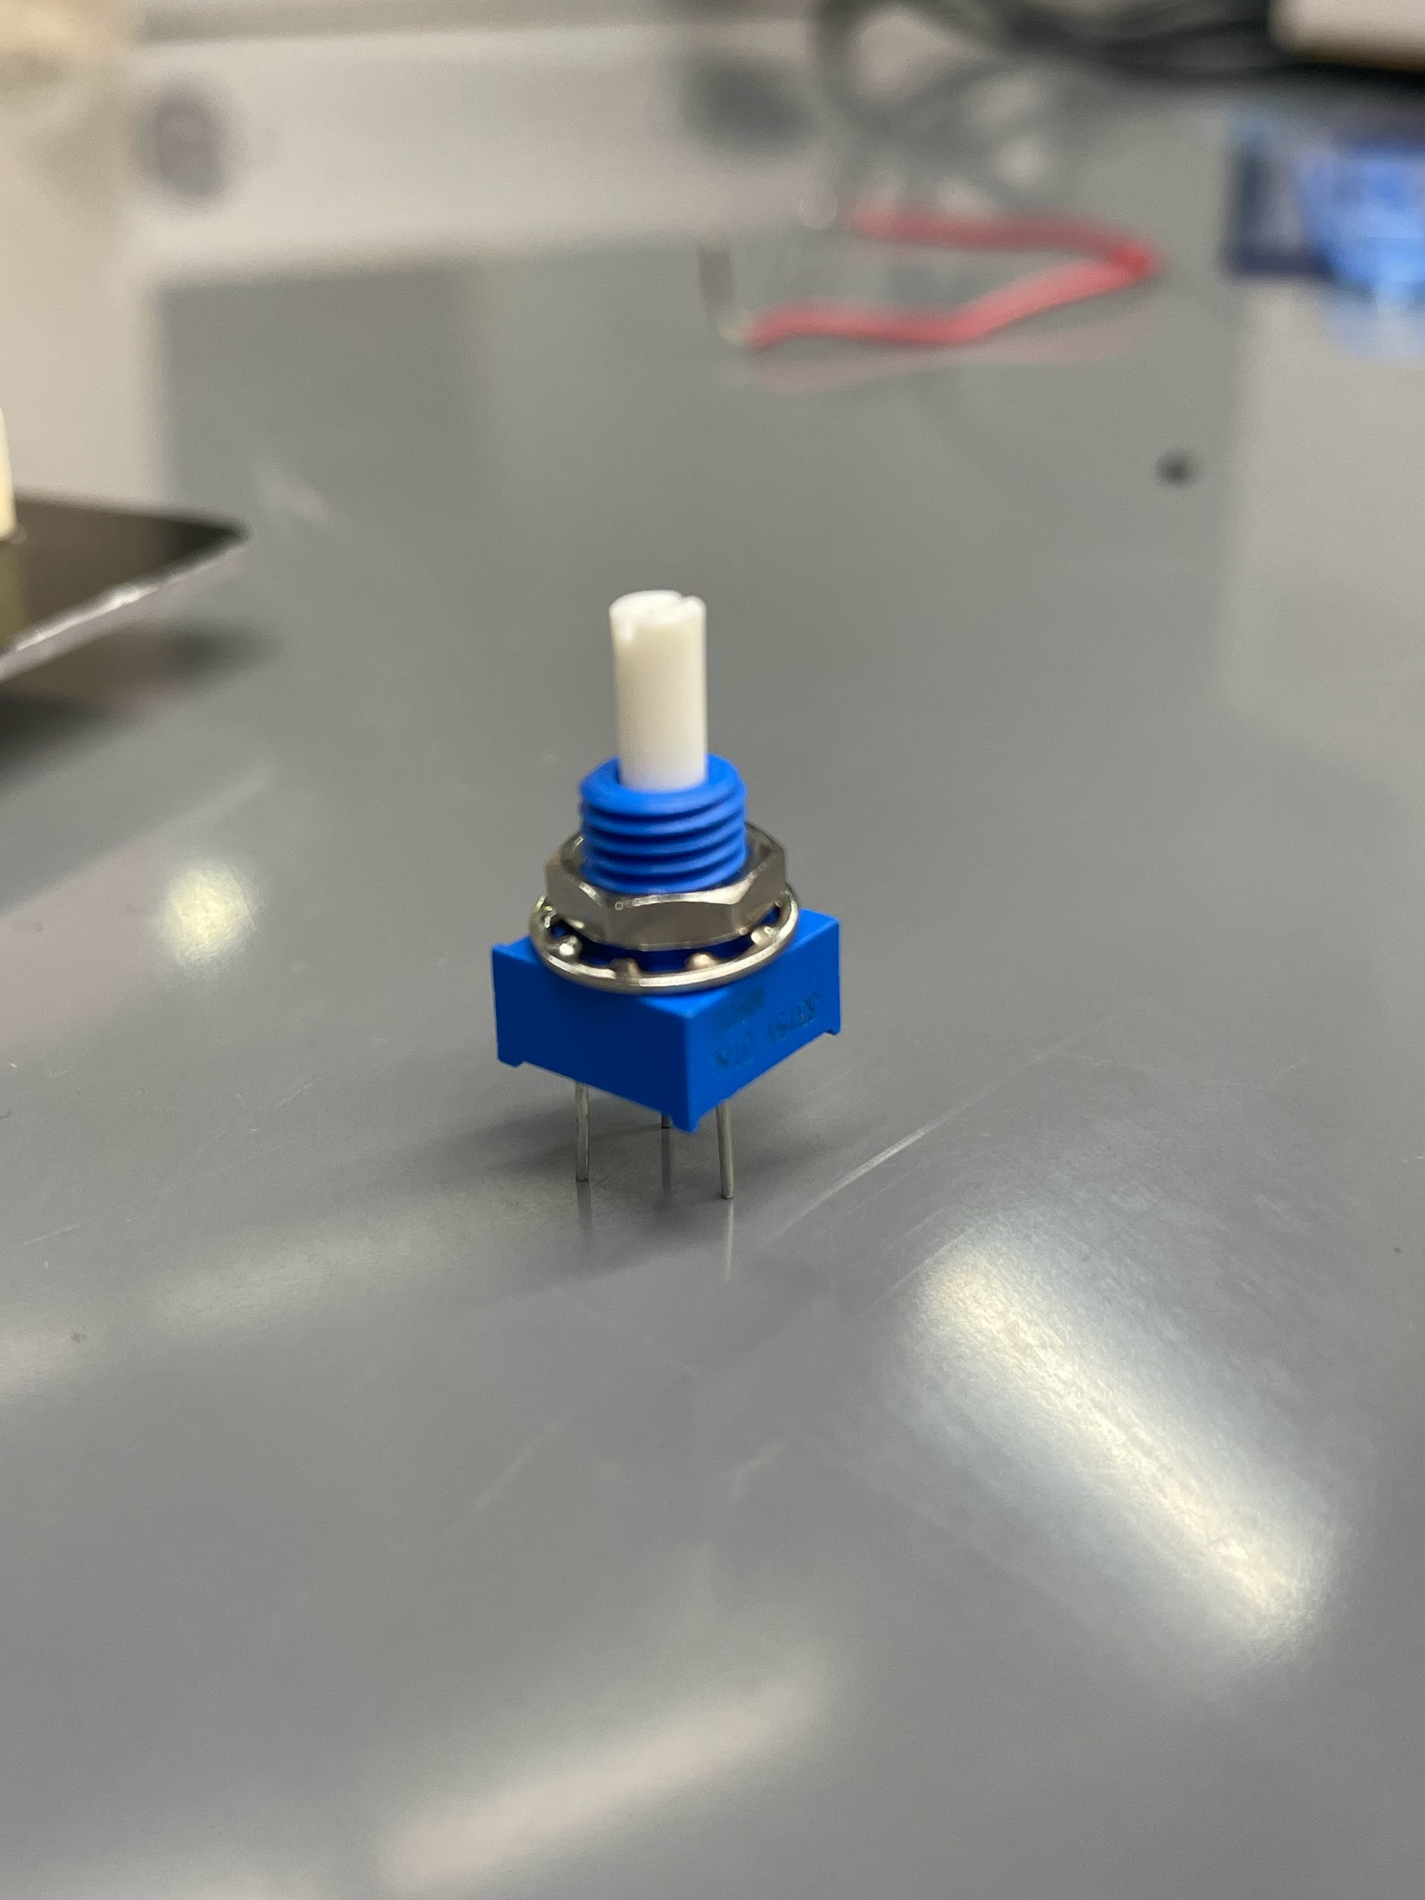
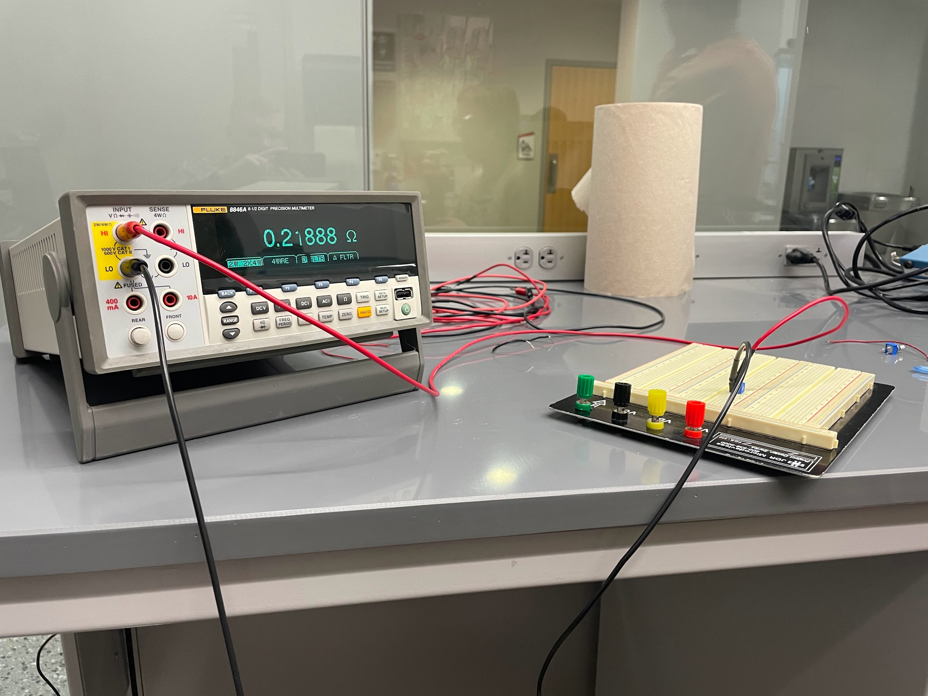
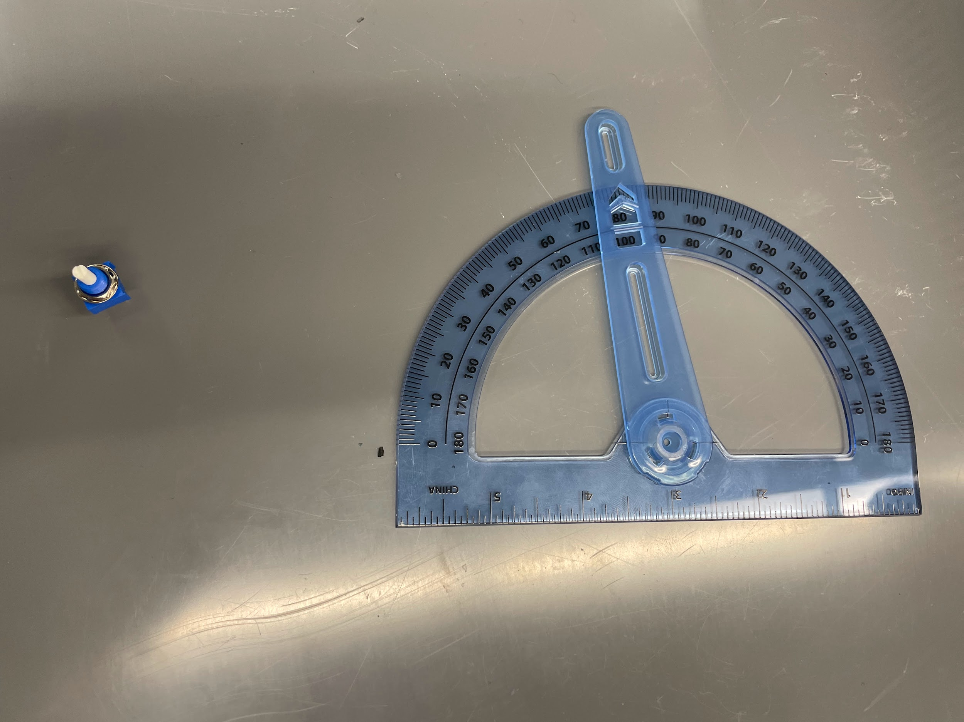
Initial Validation Testing

Slide 3
Initial Validation Testing
Tested resistance repeatedly at fully open and fully closed positions
Interpolated and tested to see if it was a linear trend - found it was mostly so with some deviations
Next: testing difference between using a logarithmic and linear scaled rotary potentiometers
0 avg | 0.2466666667
270 avg | 94704.28333
slope | 350.7556914
intercept | 0.2466666667 | Actual
90 expected ohms | 31568.25889 | 24500
180 expected ohms | 63136.27111 | 62480
135 expected ohms | 47352.265 | 42800

Slide 4
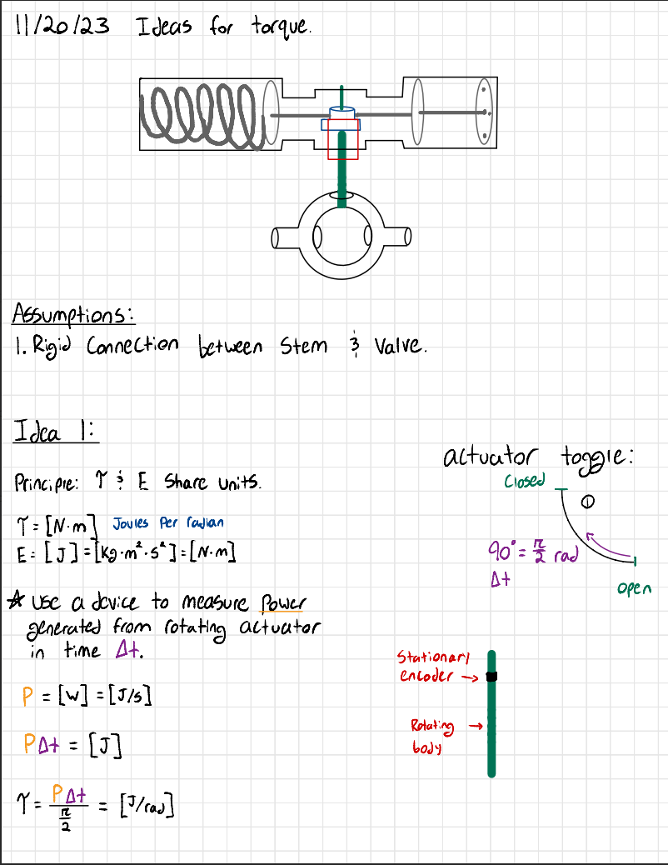
Torque Concept 1: Convert Energy to Torque

Slide 5
Torque Concept 2: Pressure Sensor
Use pressure sensor to calculate force applied to the actuator
Use force and find the radius
Use differential equations to find the radius as a function of time
This is an indirect measurement so Bray will likely want to make modifications to it

Slide 6
Progression into 402
Option 1 (Experimental approach):
Test multiple designs to find which design performs the best for collecting desire information.
Option 2 (Product approach):
Select 1 idea for position and 1 for torque and work on fully implementing into a product.

